Slide 1

WIPRO NGA Program – 25SUB4530_CP_JAVA
Capstone Project Presentation – 9th Feb & 10th Feb 2026
Project Title Here - Employee Management System
Team number - 20
Presented by – 56106-VARSHA G K
www.rpsconsulting.in

Slide 2
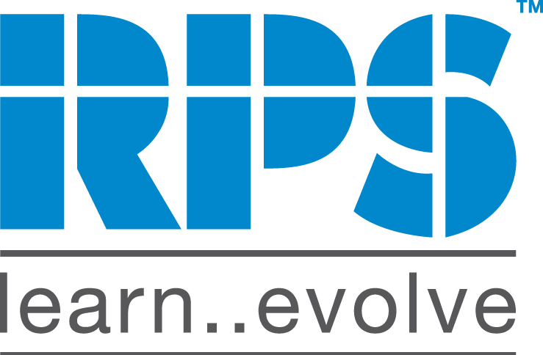
INTRODUCTION
The Employee Management System is a web-based application designed to help organizations manage employee records efficiently.
The system provides a user-friendly interface for HR or administrators to perform CRUD (Create, Read, Update, Delete) operations on employee data.
It eliminates manual record-keeping by centralizing employee information in a secure and structured database.
The frontend is developed using Angular, providing a responsive and interactive user experience with form validation and data tables. The backend is built with Spring Boot ,exposing RESTful APIs to handle business logic and database operations.
Spring Data JPA is used for seamless interaction with the relational database. The application is containerized using Docker and deployed on Microsoft Azure, ensuring scalability and easy deployment.
2024 - RPS Consulting all rights reserved

Slide 3
Business Objectives
Automate employee data management processes
Improve data accuracy and consistency
Reduce manual administrative effort
Enable quick access to employee information
Support future scalability and enhancements.
2024 - RPS Consulting all rights reserved

Slide 4
Technology Stack
Frontend Layer:
• HTML, CSS, JavaScript (User Interface)
Backend Layer:
• Java, Spring Boot (Business Logic & APIs)
• Spring Data JPA (Persistence Layer)
Database:
• MySQL (Relational Database Management System)
2024 - RPS Consulting all rights reserved

Slide 5
Frontend Module Overview
The frontend provides a user-friendly interface for administrators to manage employee records.
Key Responsibilities:
• Display employee information in structured views
• Capture and validate user input
• Communicate with backend services via REST APIs
2024 - RPS Consulting all rights reserved

Slide 6
Backend Module Overview
The backend is responsible for handling business logic, data processing, and system security.
Key Responsibilities:
• Expose RESTful APIs
• Perform CRUD operations
• Handle exceptions and validations
• Maintain data integrity
2024 - RPS Consulting all rights reserved

Slide 7
Key Features
• Centralized employee data management
• Secure and structured REST APIs
• Robust exception handling
• Input validation and error control
• Modular and maintainable architecture
2024 - RPS Consulting all rights reserved

Slide 8
DevOps & Deployment:
Docker:
Containerizes frontend and backend applications
Ensures consistent environment across development and production
Simplifies deployment process
Azure:
Hosts backend Spring Boot APIs
Hosts Angular frontend application
Supports scalability and cloud deployment
Enables easy application management.
2024 - RPS Consulting all rights reserved

Slide 9
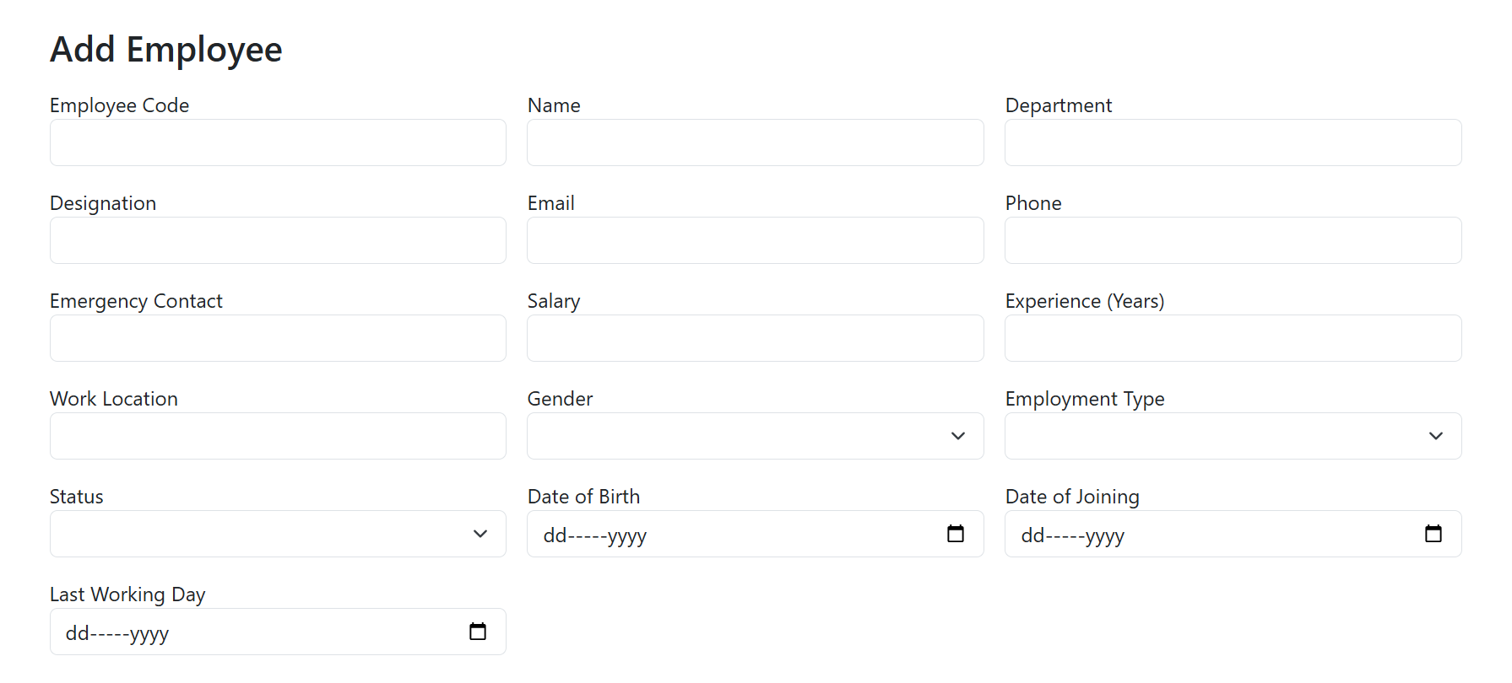
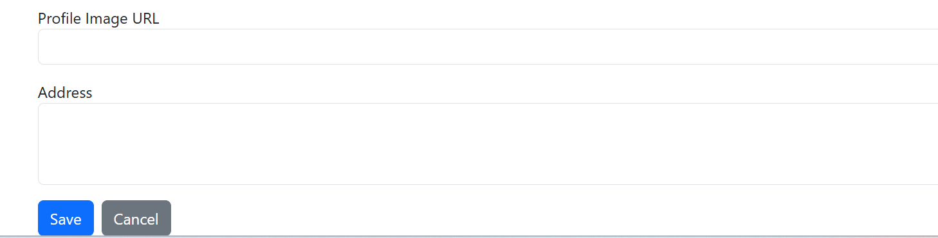
Employee Management Running Application:
2024 - RPS Consulting all rights reserved

Slide 10
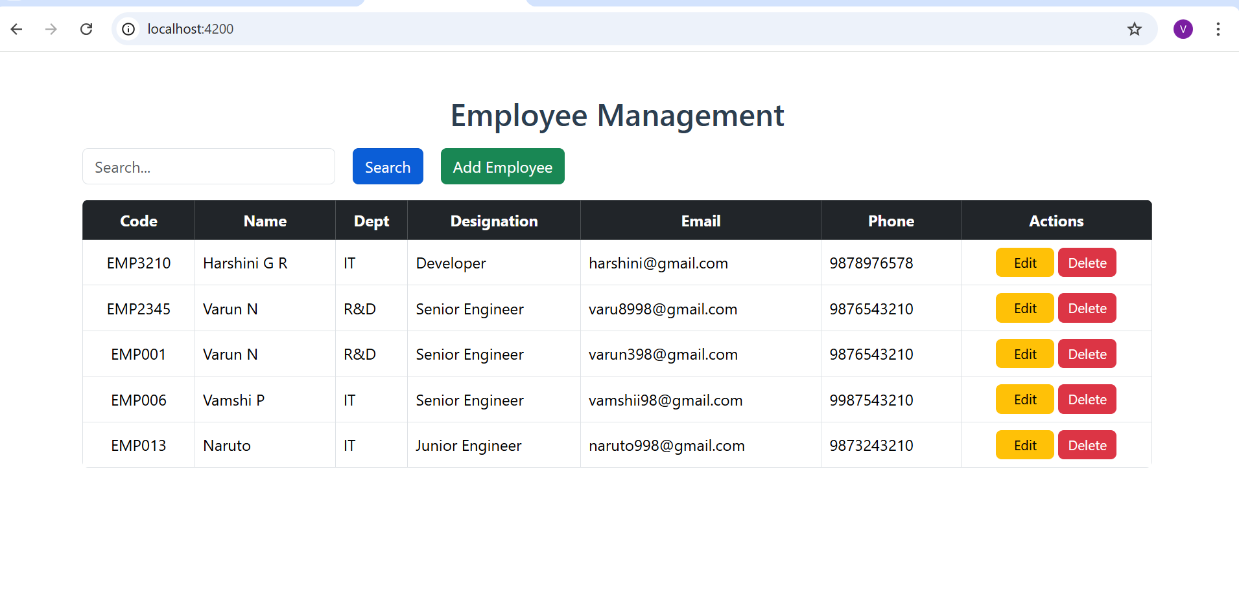
Employee Management Running Application:
2024 - RPS Consulting all rights reserved

Slide 11
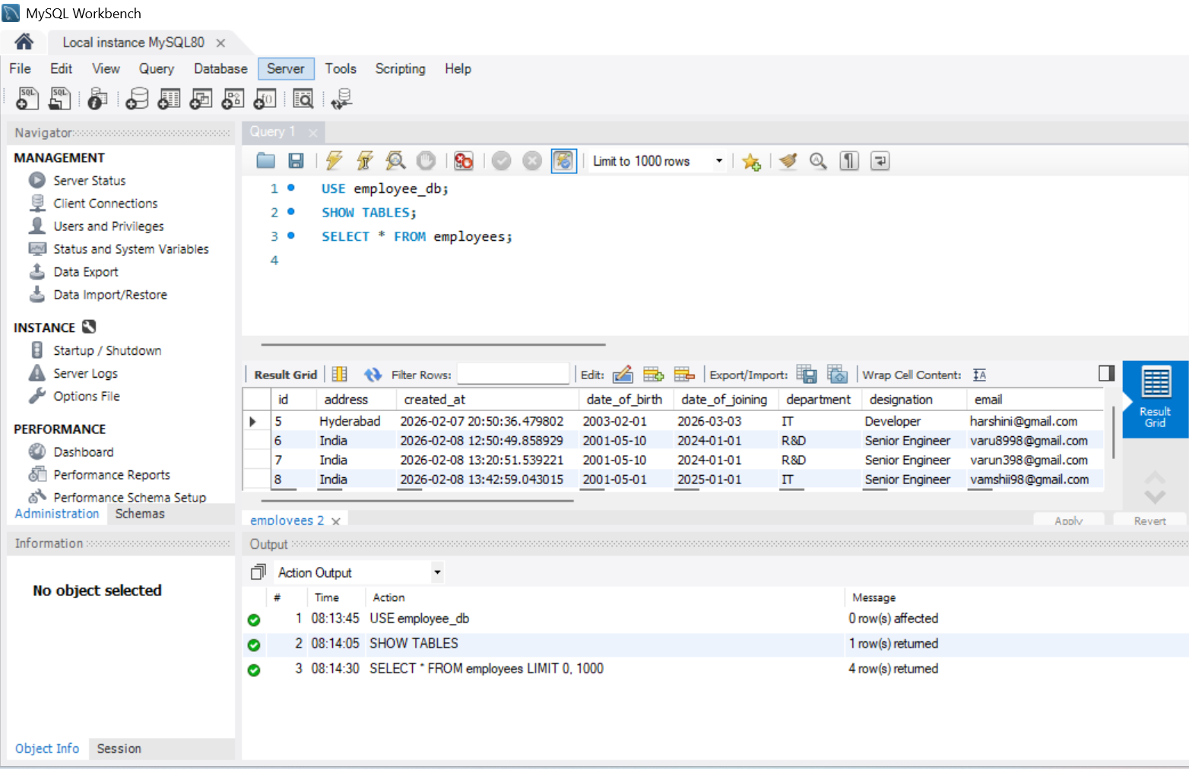
Employee Data in DB:
2024 - RPS Consulting all rights reserved

Slide 12
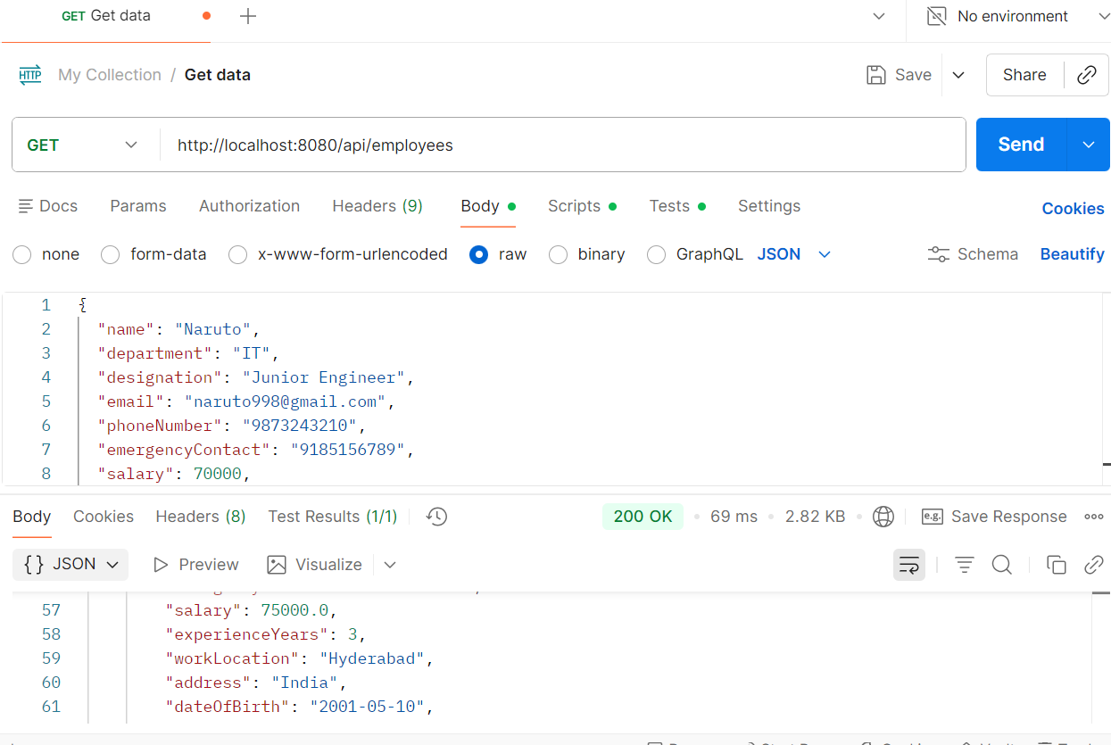
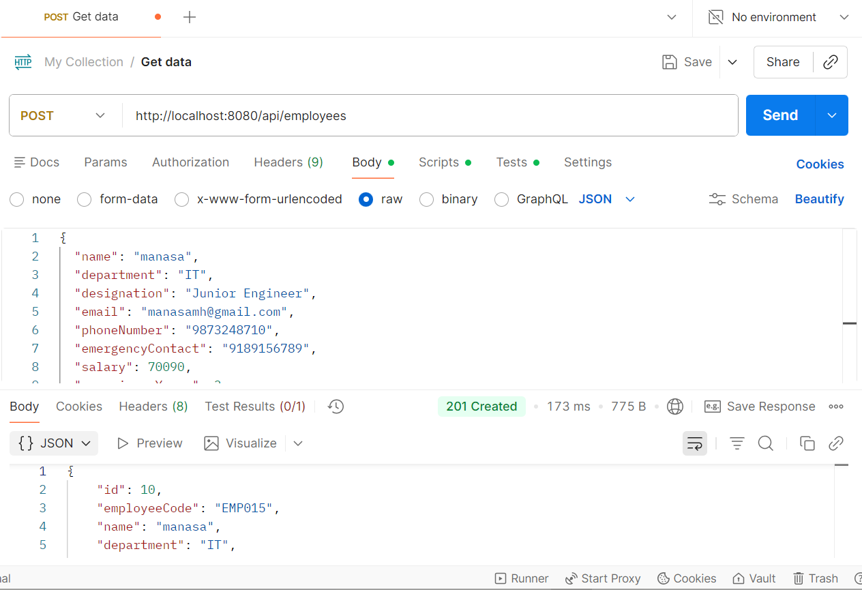
Postman Screenshots:
2024 - RPS Consulting all rights reserved

Slide 13
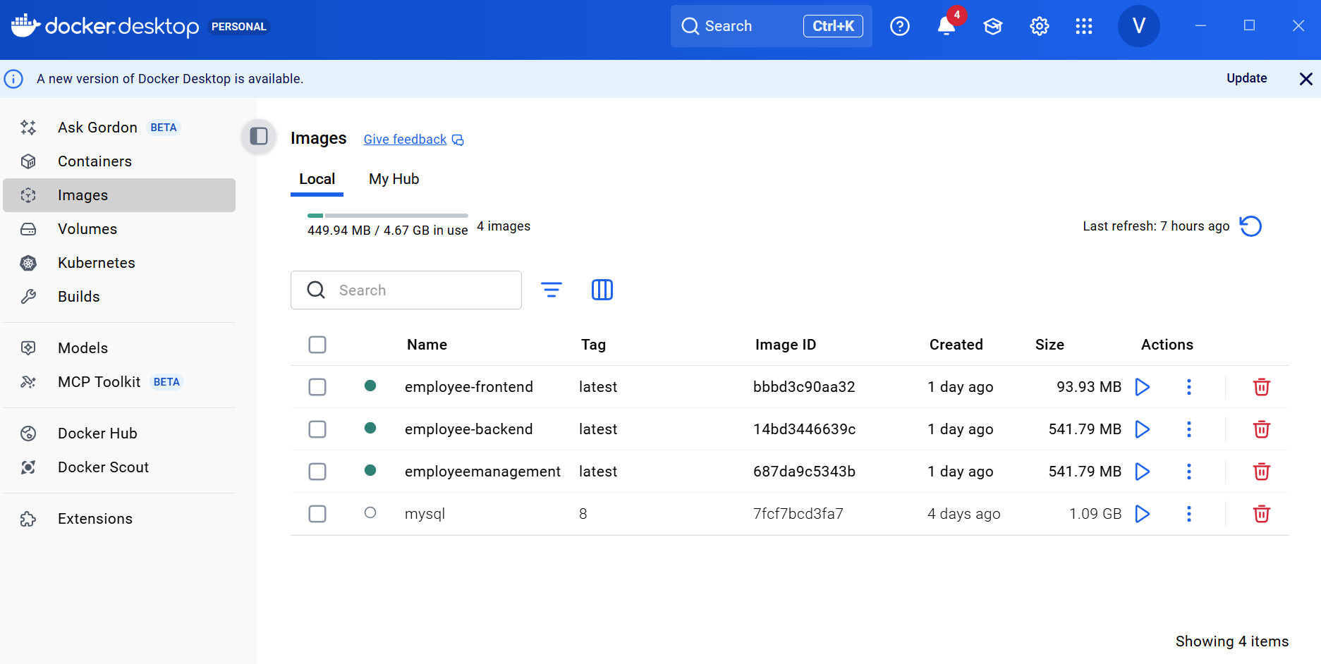
Docker Deployment:
2024 - RPS Consulting all rights reserved

Slide 14
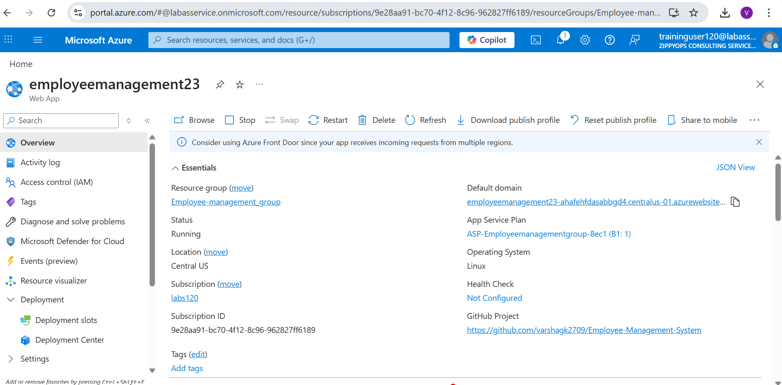
Azure Deployment:
2024 - RPS Consulting all rights reserved

Slide 15
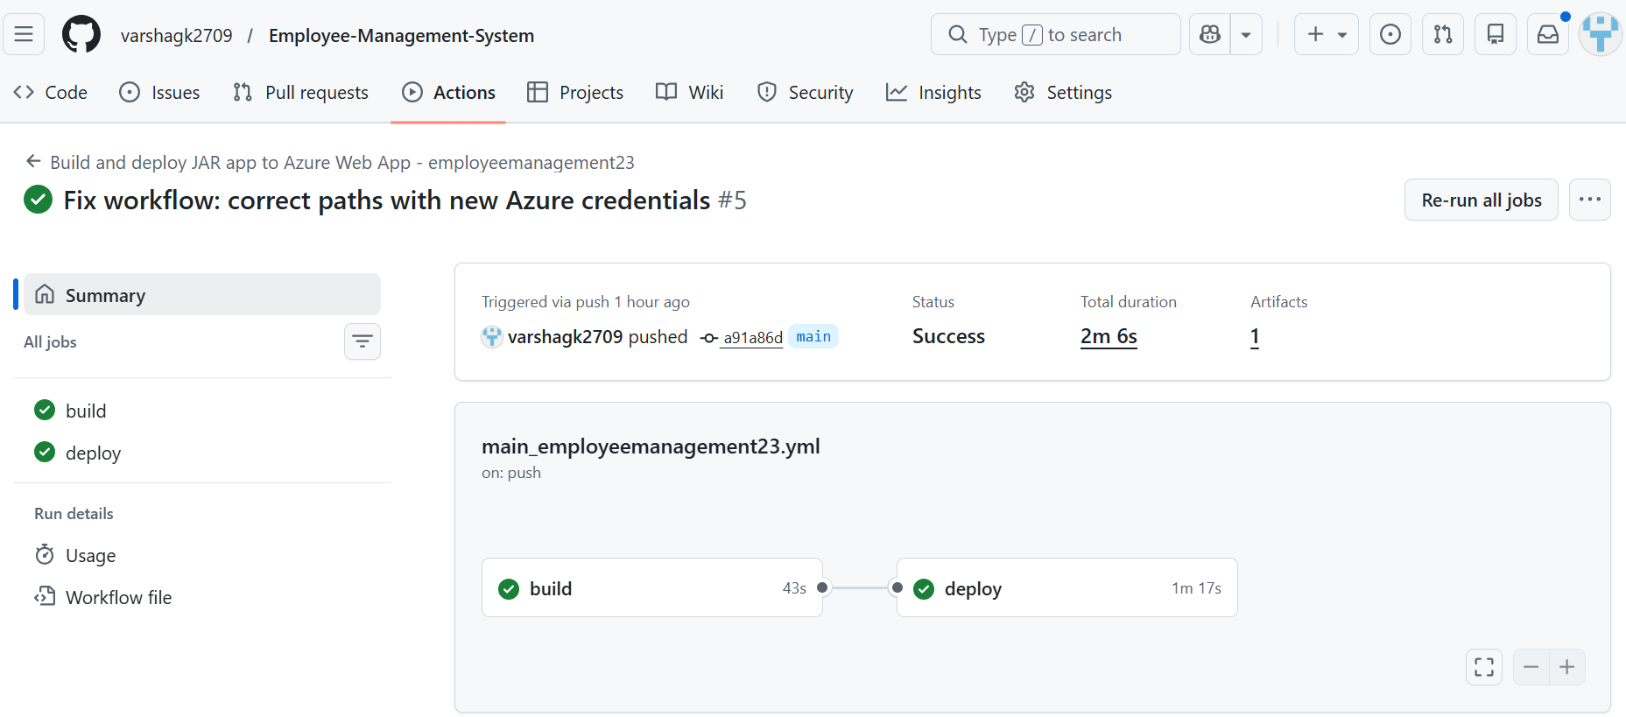
GitHub Actions:
2024 - RPS Consulting all rights reserved

Slide 16
Conclusion:
This project implements a full-stack Employee Management System using Angular, Spring Boot, and MySQL.
It supports complete CRUD operations with proper validation, REST API integration, and structured backend architecture.
The system is scalable, maintainable, and reflects real-world enterprise application design.
2024 - RPS Consulting all rights reserved

Slide 17
THANK YOU
2024 - RPS Consulting all rights reserved

